Slide 1

CQRS:
Crack for Architecture Addicts…
-or-
…An Idea Who’s Time Has Come?
DX/TED
Steve Bohlen
Principal Software Engineer
& Technical Evangelist
sbohlen@gmail.com http://blog.unhandled-exceptions.com @sbohlen

Slide 2
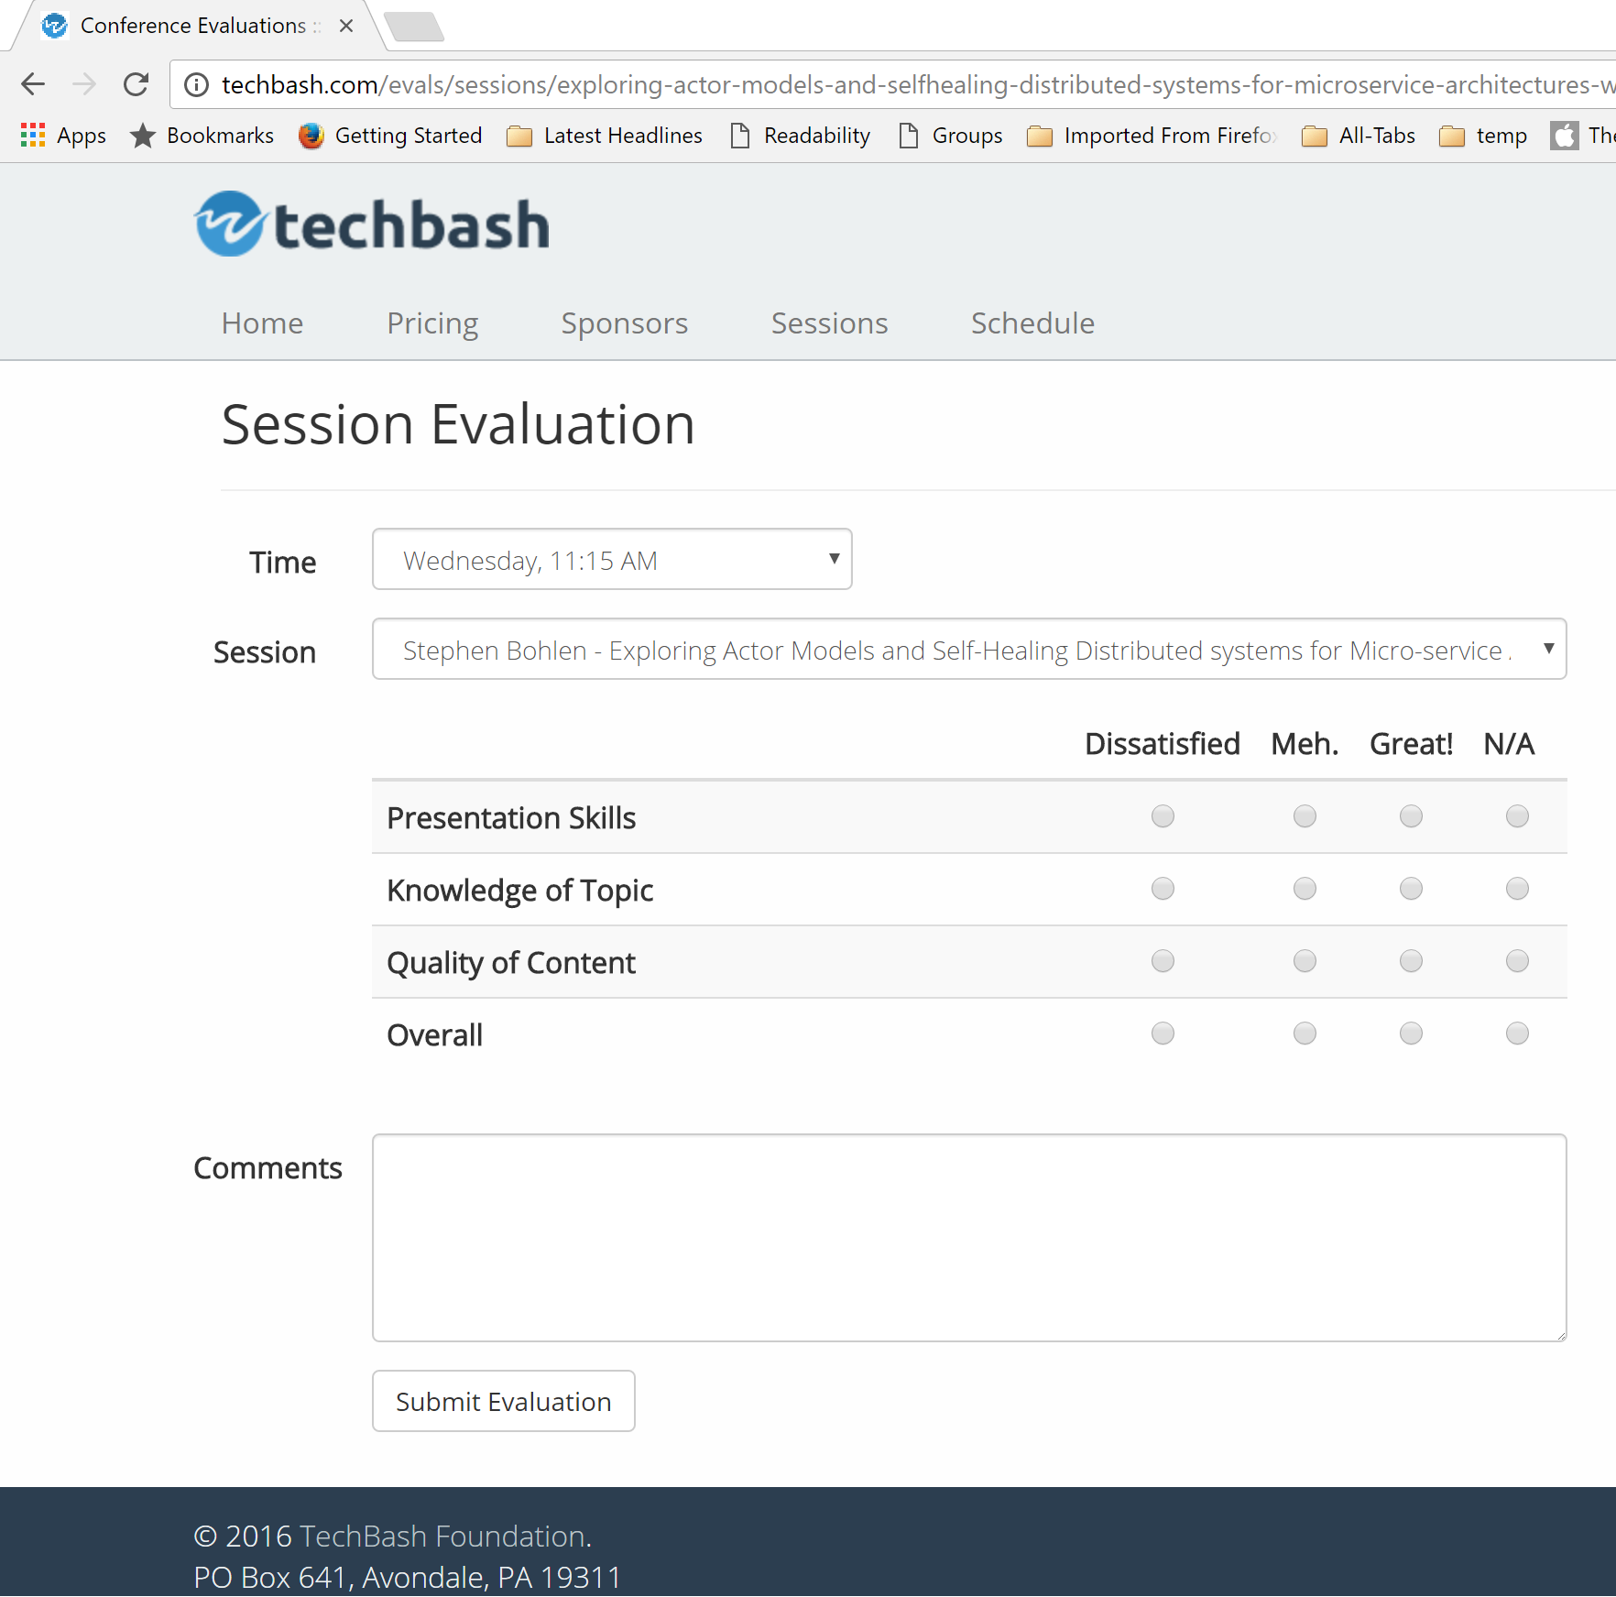




Please Complete the Evals!
http://techbash.com/schedule

Slide 3



Steve Bohlen
Over 25 years as a software developer
LISP, Delphi, C/C++, VB, VB.NET, Java, Ruby, C#, JavaScript
Principal Software Engineer, Microsoft
Co-Founder, NYC Alt.Net User Group
http://nyalt.net
Co-Organizer, NYC DDD User Group
http://dddnyc.org
Contributor: various OSS projects
NHibernate http://www.nhforge.org
Common.Logging http://net-commons.github.io/common-logging
NDbUnit http://www.googlecode.com/ndbunit
Spring.NET http://www.springframework.net
blog: http://blog.unhandled-exceptions.com
e-mail: sbohlen@gmail.com
twitter: @sbohlen
Membership: ASP Insiders, C# Insiders, Telerik Insiders, INETA Board of Directors
Alumni

Slide 4

I am a
employee…
…but these thoughts are my own!

Slide 5


Slide 6
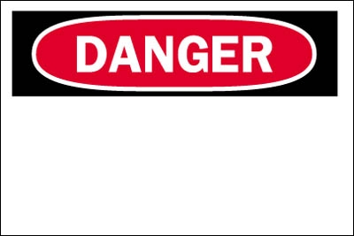
Opinions Ahead

Slide 7
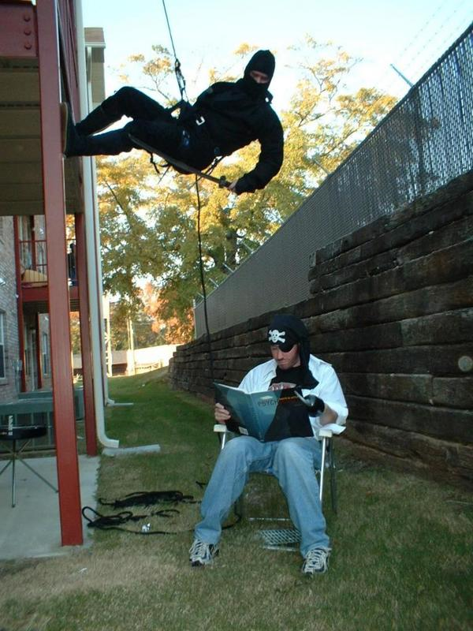

Slide 8
Agenda
What’s wrong with Traditional Application Architecture?
What is CQRS?
Commands and Events
Persistence
Understanding Event Sourcing
Exploring a simple CQRS sample app
Resources to Learn more
Q+A

Slide 9
What’s wrong with Traditional Application Architecture?

Slide 10
Traditional Architecture
Client
Return DTO
ACK Returned
LAN/WAN
Request DTO
Invoke
Remote Services
Application Services
Domain Object
Domain Object
Domain Object
Domain Object
RDBMS

Slide 11

Application Design Pain Points
Scalability of System is by larger and larger RDBMS
Surprise, surprise! ☺
Persistence means ‘save the Current State’ of the domain model
Query concerns are at odds with Transactional concerns
1NF vs. 3NF
more…

Slide 12

Domain Modeling Pain Points
Business Rules only exist in user’s heads
Converting Domain Objects to DTOs (and back again!)
Domain Object Persistence
Lazy vs. Eager Fetching
Optimizing Domain for efficient Queries
Setter/Getter Anti-Pattern
Tests are (often) brittle
more…

Slide 13
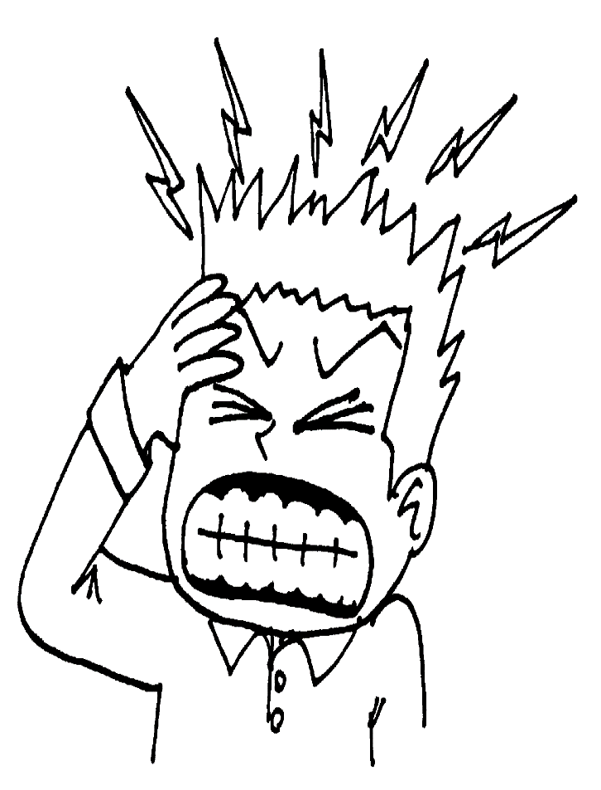
Business Pain Points
Must know what business questions we want to ask up front
Optimizing for Queries and Optimizing for Transactions are tied together (and expensive)
Evolving Requirements is hard/expensive
more…

Slide 14

Self-Delusion
One model can be made to efficiently serve two (or more!) different masters
Competing optimization needs of Queries and the Transactions can be efficiently balanced
Getters/Setters are a necessary evil
Saving the current state is the only way to think about persistence

Slide 15
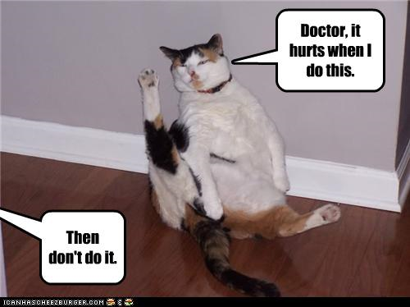

Slide 16
What is CQRS?

Slide 17
Command-Query Separation
Command-Query Separation (CQS) states that every method should either be a command that performs an action, or a query that returns data to the caller, but not both.
In other words, asking a question should not change the answer.
More formally, methods should return a value only if they are referentially transparent and hence possess no side effects.
-Bertrand Meyer, designing the Eiffel language

Slide 18
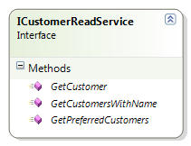
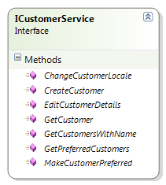
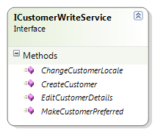
Interface Segregation Principle

Slide 19
Command-Query Responsibility Segregation
The CQS principles applied to your domain modeling and system architecture
Enable each element of your architecture to be optimized for a single responsibility
Decomposition for your architecture rather than just for your objects

Slide 20
Slicing and Dicing our Architecture
Client
Return DTO
ACK Returned
LAN/WAN
Request DTO
Invoke
Client
Server
Remote Services
Application Services
Domain Object
Domain Object
Domain Object
Domain Object
RDBMS
Read
Write

Slide 21
Refactoring our Architecture
Client
Return DTO
ACK Returned
LAN/WAN
Request DTO
Invoke
Remote Services
Remote Services
Remote Services
Application Services
Application Services
Domain Object
Domain Object
Domain Object
Domain Object
Light-Weight Query Services
Persistence
RDBMS
Persistence
Read
Eventually
Write

Slide 22
Scaling our Systems
Write
Read
C
A
P
CAP Theorem:
onsistency, vailability, artition-Tolerance; pick any two!
C
A
P

Slide 23
Commands and Events in CQRS

Slide 24
Refresher: the Aggregate Root Pattern
Aggregate Boundary
Aggregate Boundary
Entity1
Entity1
Entity2
Entity2
Entity3
ValueObject1
Aggregate Boundary
ValueObject1
Entity1
ValueObject2
ValueObject1
ValueObject2

Slide 25
The BIG Idea
OrderPlaced
Event
Command
Aggregate Root
Event
Event
PlaceOrder
Command
Order Domain Object
CustomerCharged
Event!

Slide 26
The even BIGGER Idea
Command
Aggregate Root
Event
Event
Command Handler
Aggregate Root
Event
Event Handler
Event Handler
Event Handler
Event Handler
Event Handler
Application
Domain

Slide 27
Domain Testing (conceptual)
Command
Aggregate Root
Event
Event
Command Handler
Aggregate Root
Event
Event Handler
Event Handler
Event Handler
Event Handler
Event Handler
Input
Output

Slide 28
Understanding Commands
Commands are directives to the domain to perform some action
Commands may be declined/rejected by the domain for various reasons
Processing a Command will result in 0:n Events raised
Commands are always in the imperative:
PlaceOrder, not OrderPlaced
Recall: in DDD, lexical differences matter
Commands are a component of the Ubiquitous Language we use to describe our domain

Slide 29
Demystifying Commands
public class PlaceOrderCommand
{
//properties
public readonly Guid OrderId;
public readonly string Comment;
//ctor
public PlaceOrderCommand(Guid id, string comment)
{
OrderId = id;
Comment = comment;
}
}

Slide 30
Understanding Events
Events are the result of some action having already happened in the Domain
Events may never be declined/rejected; they are evidence that something already happened
Events are always in the past-tense:
OrderPlaced, not PlaceOrder
Recall: in DDD, lexical differences matter
Events are a component of the Ubiquitous Language we use to describe our domain

Slide 31
Demystifying Events
public class OrderPlacedEvent
{
//properties
public readonly Guid OrderId;
public readonly Guid ConfirmationId;
public readonly string Comment;
//ctor
public OrderPlacedEvent(Guid orderId,
Guid confirmationId,
string comment)
{
OrderId = orderId;
ConfirmationId = confirmationId;
Comment = comment;
}
}

Slide 32
Persistence in CQRS

Slide 33
Compromises in Persistence Needs
Query (read) optimization and Transaction (write) Optimization needs are in opposition
1NF for queries, 3NF for transactions
Scalability needs (imbalanced Reads and Writes)
Even RDBMS vendors acknowledge this
OLTP vs OLAP
One set of optimizations shared between Read and Write will by definition be suboptimal for each

Slide 34
Choose the Proper Persistence
Optimize the Read store for Queries
Optimize the Write store for Transactions
Let each side be designed for its single-purpose role
Don’t try to twist a single persistence store into doing “double-duty”
It will do neither well
RDBMS is no longer our only choice for persistence
NOSQL (not “NoSQL”) choices offer different pros/cons today

Slide 35
Event Sourcing in CQRS

Slide 36
Thinking More About Events
Events are past-tense
An Audit-Log of the entire Domain for the life of the system
A history of what happened over time
not a record of the state of the domain at a point in time

Slide 37
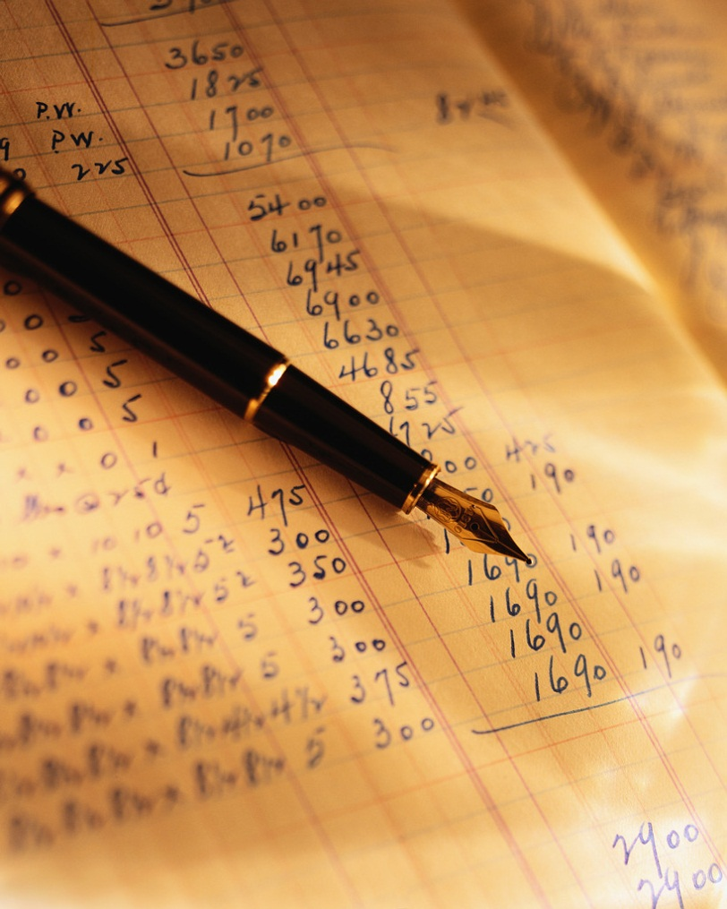
Event Sequencing vs. State

Slide 38
Event Sequencing vs. State
Search for Product 1
Add Product 1 to Cart
Search for Product 2
Add Product 2 to Cart
Remove Product 1 from Cart
Final State: Cart with Product 2 in it

Slide 39
Event Store Concepts
Read to Beginning
Replay Forward
Read
Replay
10
9
8
7
6
5
4
3
2
1
10
9
8
7
6
5
4
3
2
1
snap

Slide 40
Events and Domain Persistence
Saving our Aggregate is just serializing events
Loading our Aggregate becomes:
/* load the snapshot for this aggregate
or if no snapshot, begin w/ empty ‘default’ */
var customer = customerRepo.LoadById(customerId);
//replay the events to make its state ‘current’
customer.ReplayAllEvents();
//customer ready to accept commands now
Consider: Do we still need an ORM now?

Slide 41
Exploring a Simple CQRS Sample in Code

Slide 42
Should I do CQRS?
Absolutely Not!
…or at least “Probably Not” ☺

Slide 43
Additional Resources
Central Hub for All Things CQRS
http://www.cqrsinfo.com
Udi Dahan’s on CQRS (et. al.)
http://www.udidahan.com/2009/12/09/clarified-cqrs/
Simple CQRS Sample Application
https://github.com/gregoryyoung/m-r
Comprehensive CQRS Sample Application
https://github.com/MarkNijhof/Fohjin
Jonathan Oliver’s Post on his Event Store project
http://blog.jonathanoliver.com/2010/07/cqrs-event-store/
Rinat Abdulluin on Getting Started with CQRS
http://abdullin.com/cqrs/
Greg Young on Testing Using Events (video)
http://skillsmatter.com/podcast/design-architecture/talk-from-greg-young

